Slide 1


CW 3
- AUTOMOTIVE AIR CONDITIONING CONTROL PANEL
By:
Fahd Mohamed & Omar Youseff

Slide 2

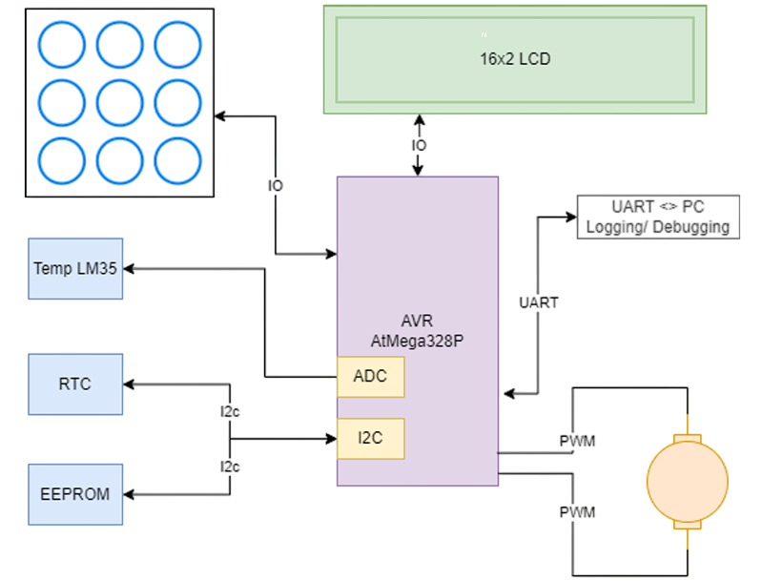
Project Brief

Slide 3
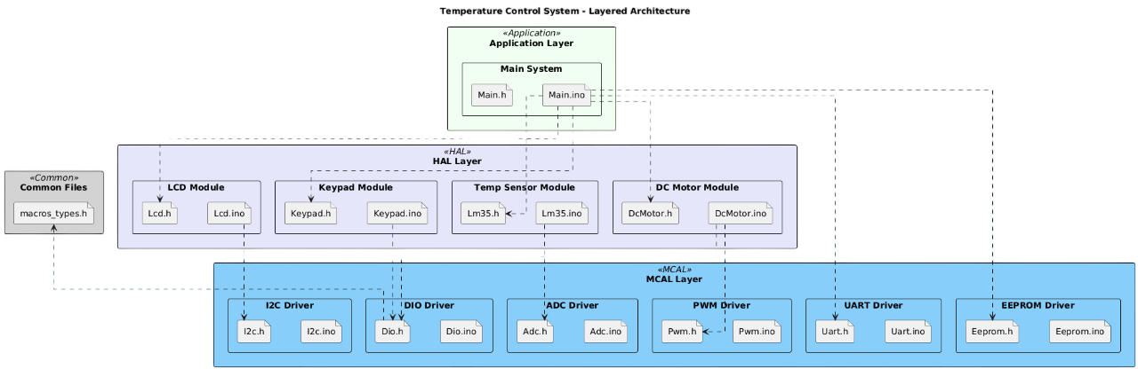
System Include Architecture
Notes:
Briefly explain key dependencies, such as the Lcd module relying on the I2c driver for communication, or the DcMotor module relying on Pwm for speed control.

Slide 4
SW Test Cases vs Use Cases
Methodology: All test cases are documented and executed using the standardized Robot Framework methodology (Arrange, Act, Assert).
Coverage: Ten (10) distinct test cases were developed to verify system operation across all modes and boundary conditions.
Critical Verification: Tests confirm the implementation of the minimum requirements:
Validation of bi-directional motor control and speed adjustment.
Verification of accurate temperature configuration using the keypad.
Confirmation of correct Auto Mode logic and EEPROM data persistence.

Slide 5
Keypad Configuration
Key 3 (Mode Select): Toggles between AUTO (Temperature-driven) and MANUAL modes.
Key 1 (Fan Power): Toggles fan ON / OFF (Only active when in Manual Mode).
Key 5 (Direction Toggle): Switches operation between Cooling (Forward) and Heater (Reverse) modes.
Key 6 (Temp Up): Increases the target temperature setpoint (+1°C).
Key 4 (Temp Down): Decreases the target temperature setpoint (-1°C).
Key 2 (Speed Up): Increases fan speed by 10% (Max 100%).
Key 8 (Speed Down): Decreases fan speed by 10% (Min 10%).

Slide 6
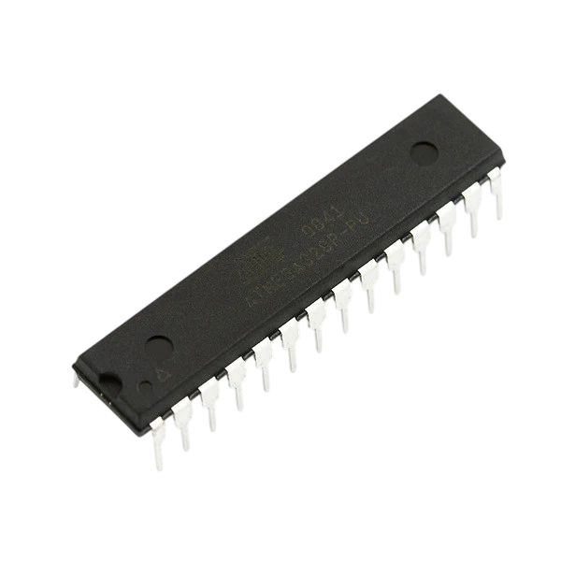
BOM
Optimization Strategy: The final BOM represents the transition from development-grade modules to a production-optimized, cost-effective solution.
Component Reduction: The expensive Arduino Uno development board is replaced by a bare ATmega328P chip, requiring only necessary discrete components (crystal, capacitors, regulator).
Driver Efficiency: Integrated circuits (ICs) such as the L293D chip are used instead of larger, pre-built driver modules (like the L298N module) to reduce component size and manufacturing cost.
Cost Analysis: there will be a large final cost reduction achieved.

Slide 7
THANK YOU

